Slide 1

PROJECT PRESENTATION
FASHION MNIST

Slide 2
INTRODUCTION

Slide 3
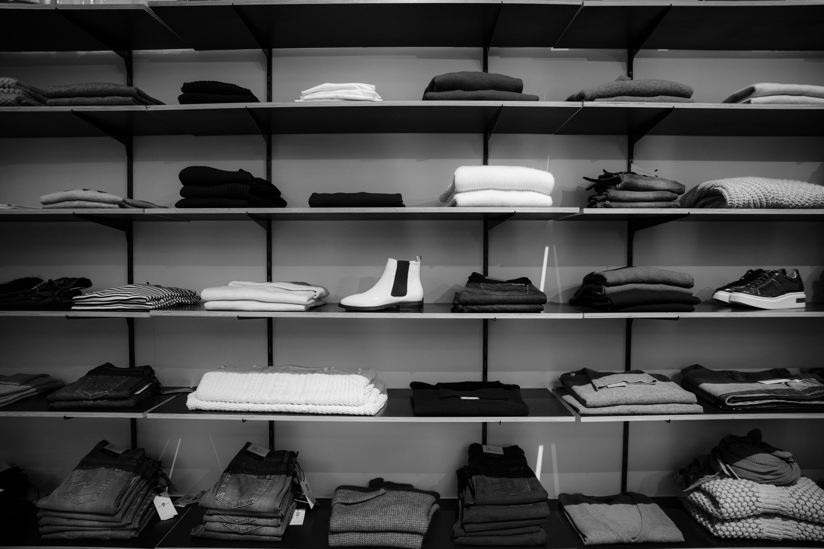
Problem
In the world of fashion, automated systems for identifying and categorizing apparel are critical for improving efficiency in retail, e-commerce, and inventory management. However, accurately classifying fashion items from images is challenging due to variations in style, lighting, and design. This calls for robust and intelligent models capable of distinguishing subtle differences between categories like shirts, dresses, and coats.
Idea
This project aims to leverage the Fashion MNIST dataset, a well-known benchmark for image classification tasks, to build a deep learning model from scratch. The goal is to train a neural network that achieves high accuracy in categorizing images into one of 10 fashion item categories. This involves exploring techniques in data preprocessing, model design, and training optimization to achieve state-of-the-art performance.

Slide 4
DATASET DESCRIPTION

Slide 5
Key Features
  Classes: 10 categories of fashion items:
    T-shirt/top, Trouser, Pullover, Dress, Coat, Sandal, Shirt, Sneaker, Bag, Ankle Boot.
  Number of Samples:
    Training set: 60,000 images
    Test set: 10,000 images
  Image Dimensions: 28×28 pixels.
  Grayscale: Single-channel images with pixel intensity values ranging from 0 to 255.
  Balanced Dataset: Each class has an equal number of images.
Dataset Format
  Input Data: Images are stored as 28×28 NumPy arrays.
  Labels: Categorical values (0-9) representing the fashion categories.
Dataset Description
The Fashion MNIST dataset is a widely-used benchmark in machine learning and computer vision. It consists of grayscale images representing 10 different categories of fashion items, making it ideal for image classification tasks.

Slide 6
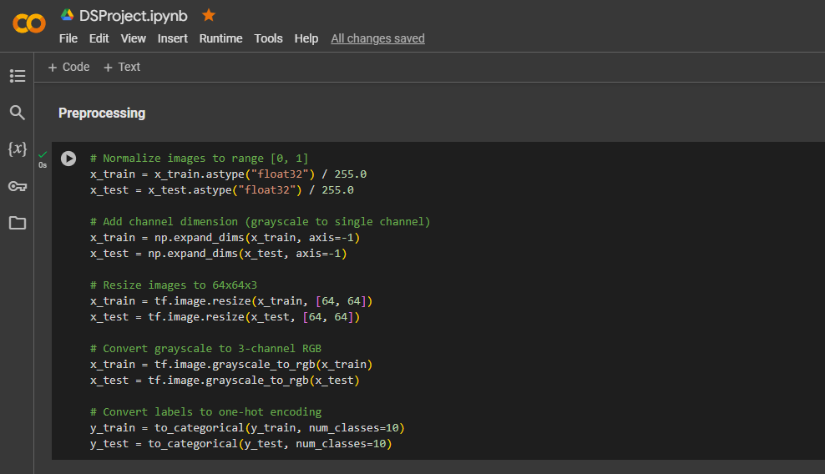
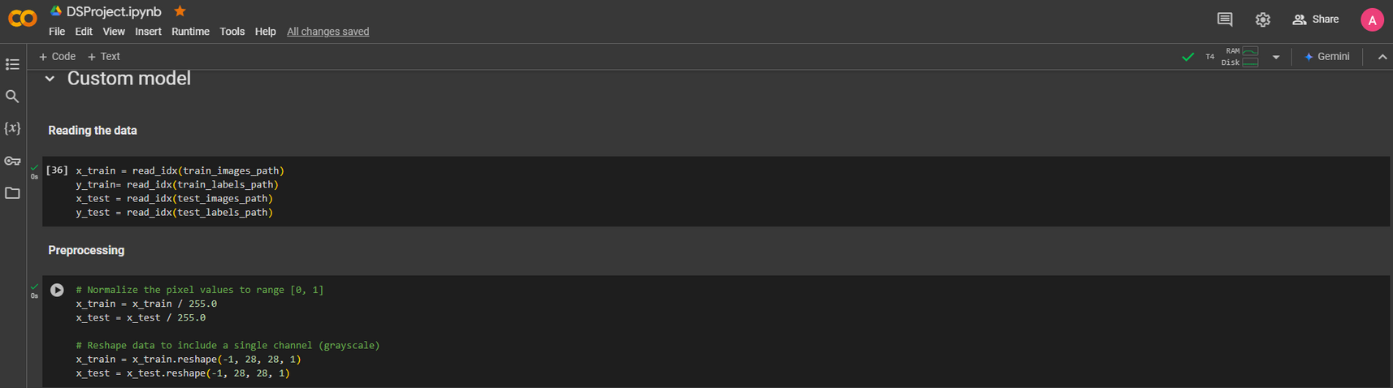
Preprocessing

Slide 7
MODELS

Slide 8
Why we choose it ? (Vgg 16)
We Have tried other models like (Mobile Net V2) , (Capsule Networks) and they give us lower evolution than vgg 16 model.

Slide 9
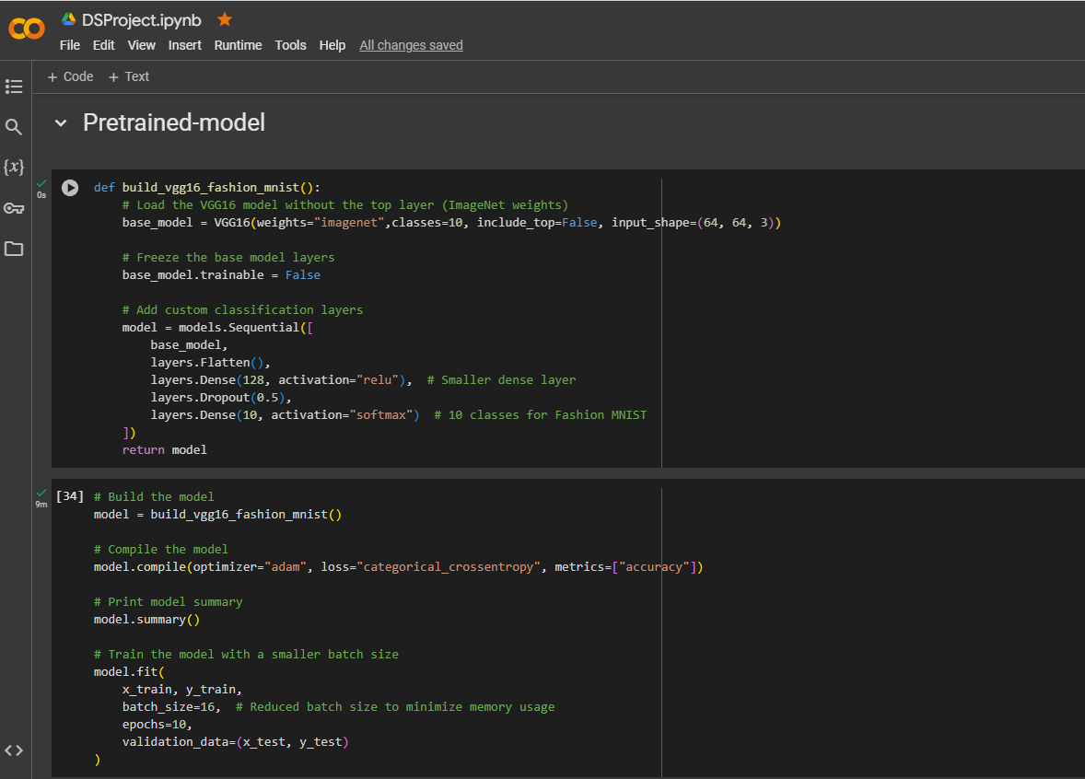
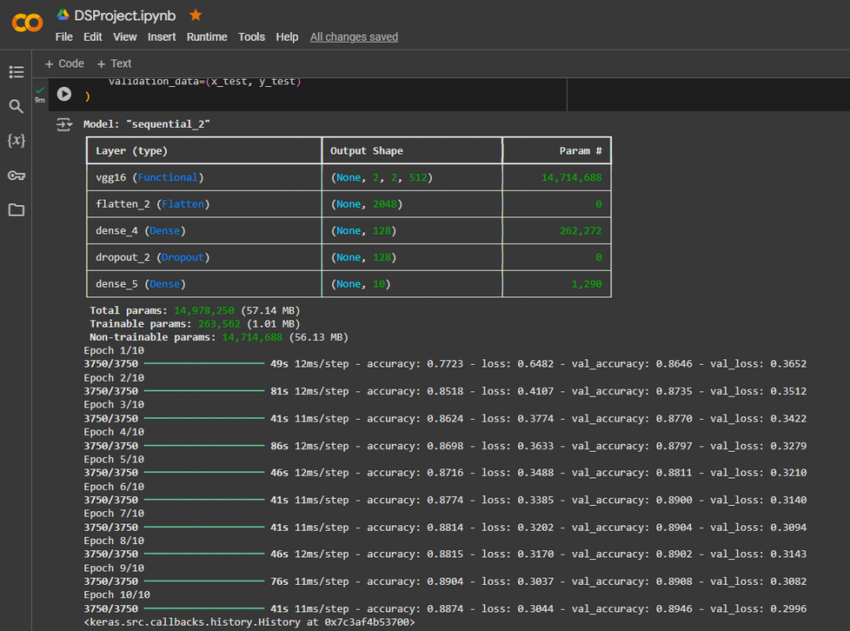
The Model and our Modification

Slide 10
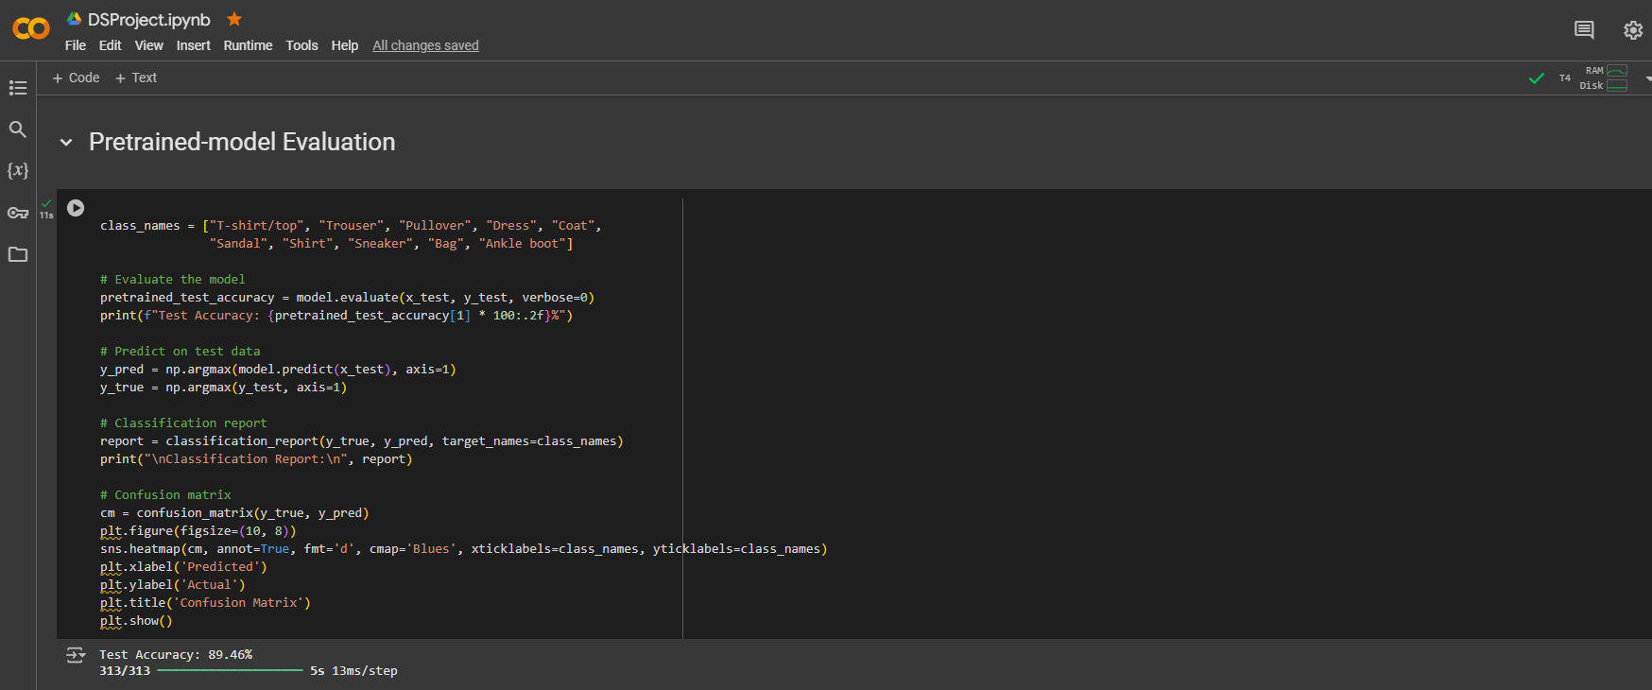
Our evaluation

Slide 11
RESULTS & CONCLUSION

Slide 12
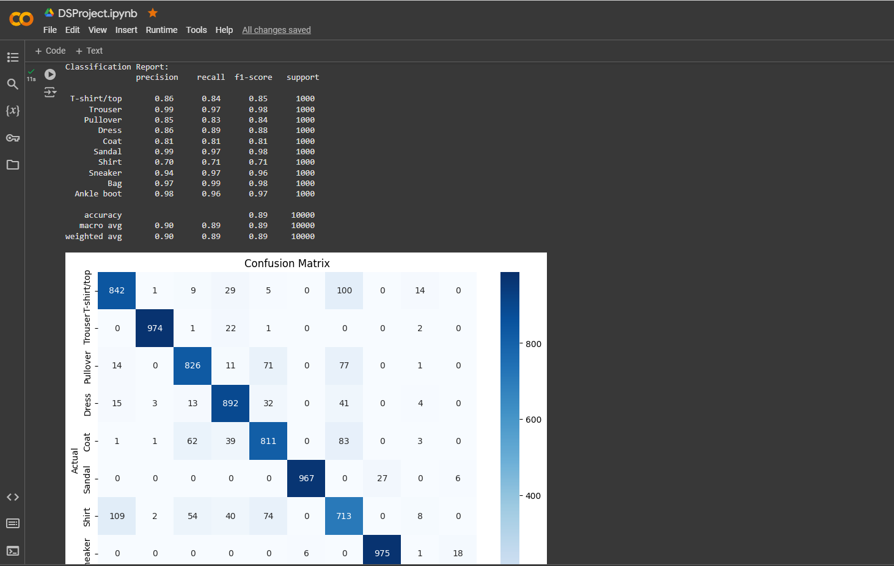
Results of Pretrained Model

Slide 13
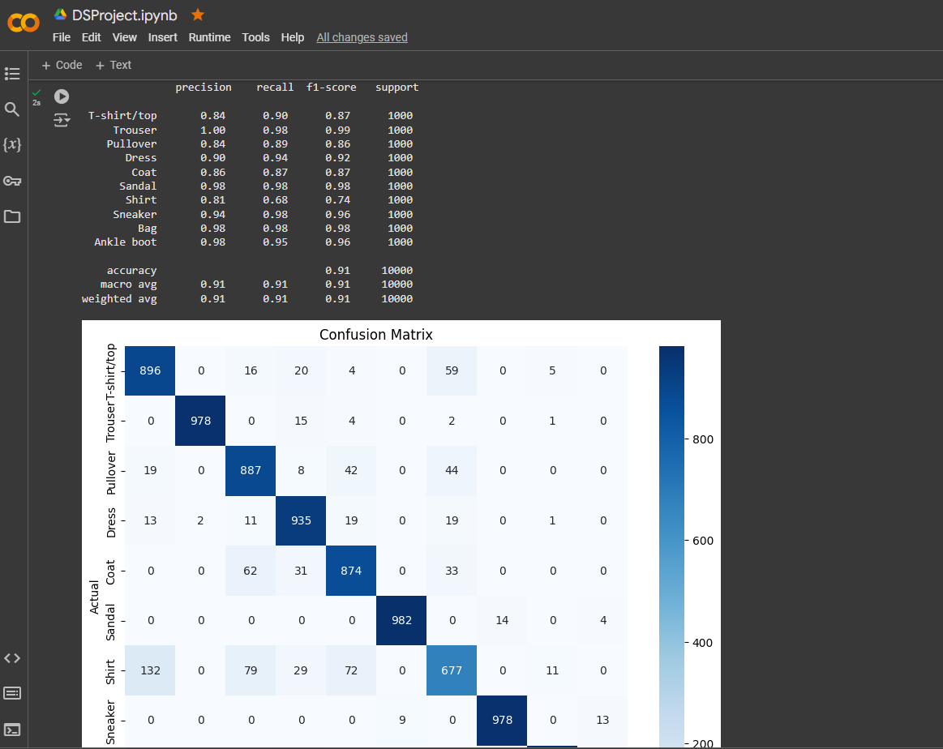
Results of Custom Model

Slide 14
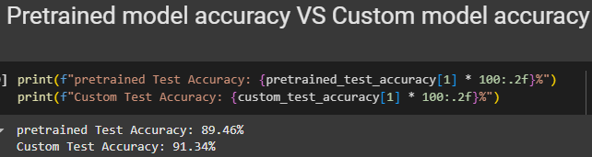
Conclusion
In this project, we successfully developed a deep learning model from scratch to classify images in the Fashion MNIST dataset into their respective categories. By leveraging advanced techniques in model architecture and training optimization, we demonstrated the power of neural networks in solving complex image classification problems. This work not only highlights the potential of deep learning in fashion-related applications but also lays the groundwork for future innovations in automated apparel recognition and beyond.

Slide 15
Thank you!
Any Questions?

